Slide 1
Re:Pink
THE MOTOR SHOW GAME

Slide 2
Team members
Leong Wai Men
Val Tay
Clement
Jeri
Glenda

Slide 3
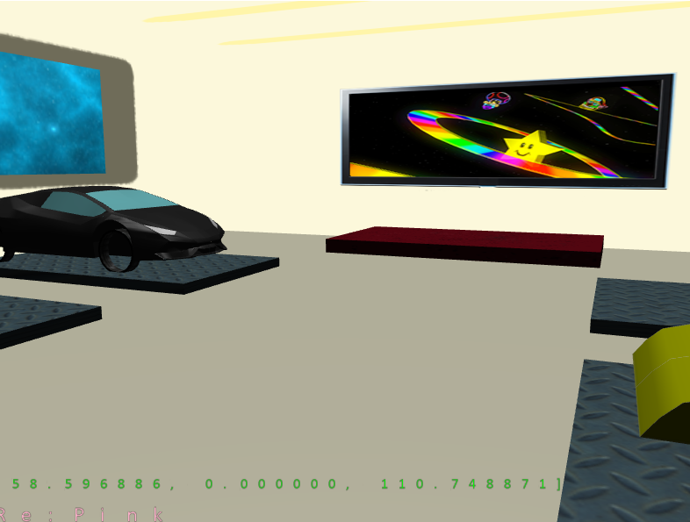
Overview/About the game
Re:Pink features a futuristic car showroom where players get to choose between the 4 amazing futuristic cars displayed. They can take each car for a test drive or play mini games such as Flappy Car and Car Surfers!

Slide 4
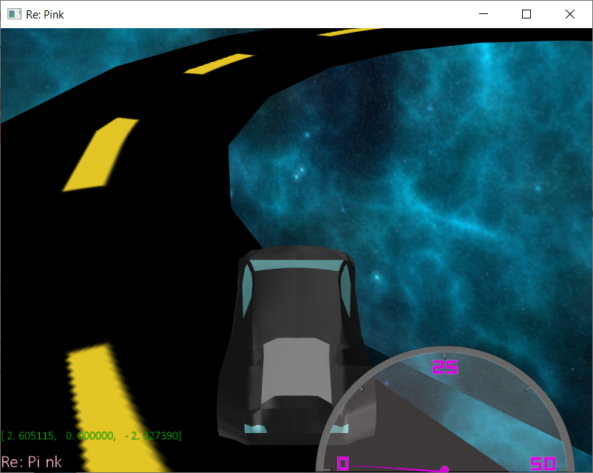
Unique Selling Point
FOUR futuristic cars waiting to be tested by YOU
Test Drive area is in SPACE
2 extra minigames
Flappy Car
Car Surfers

Slide 5
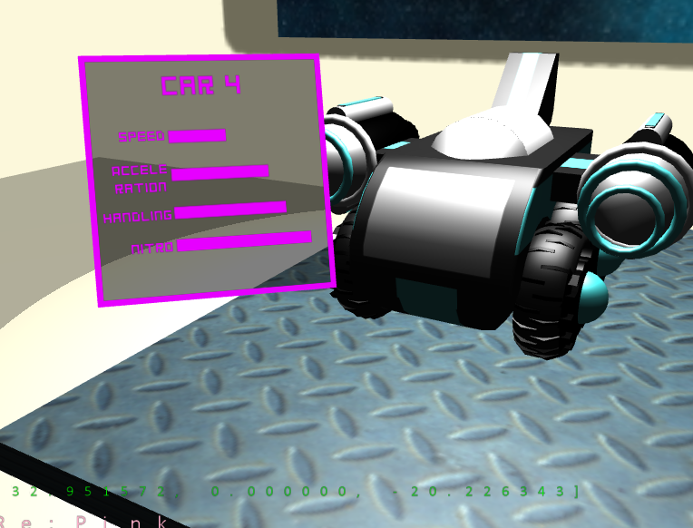
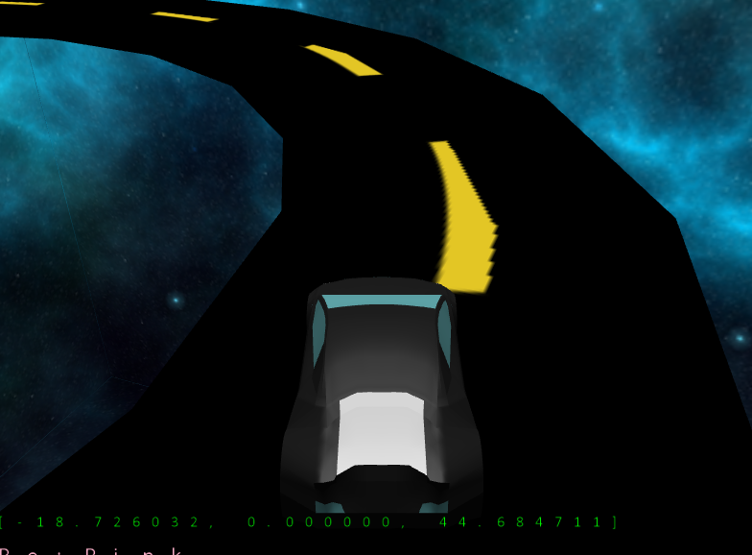
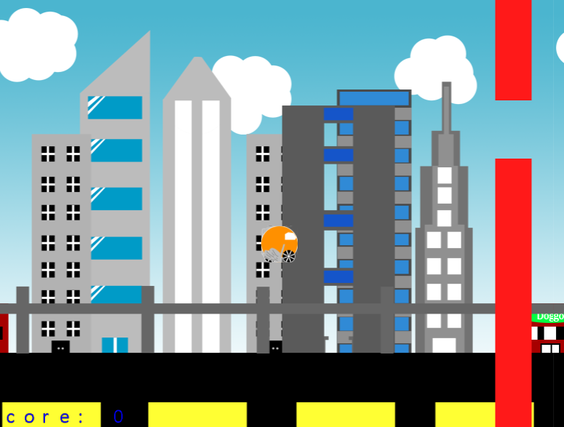
Features : Camera
Flappy Car: 2D Camera
Selection Screen: 1st Person Camera
Test drive: 3rd Person Camera

Slide 6
Features : Selection Screen
Camera: 1st Person Camera
Interactions:
4 Cars for players to select
Enter 3 different game mode

Slide 7
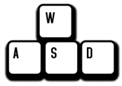


Selection Screen: Controls
WASD -> Move around
Mouse -> Look Around
Z -> Interaction (for selection of car and selection of game mode)

Slide 8
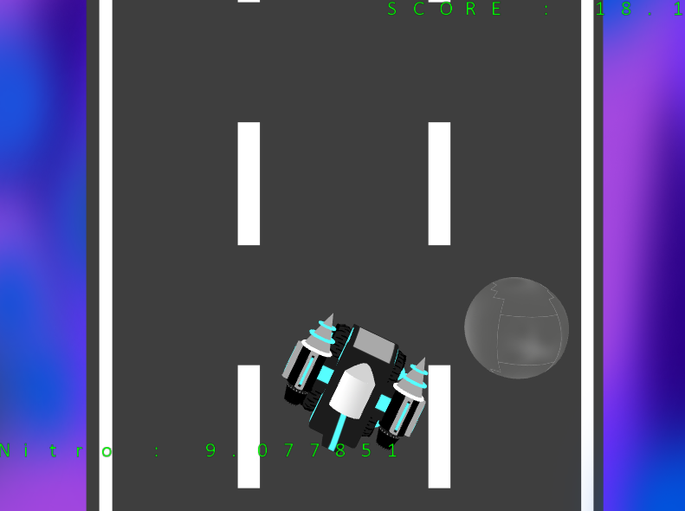
Features: 3 Games
Players get to choose between one of the three games to play from the selection screen:
Test Drive
Flappy Car
Car Surfers

Slide 9
Test Drive
Camera: 3rd Person Camera
Player get to choose 1 out of the 4 cars to test drive it
Car can fall off the track
But will be teleported back to its starting position

Slide 10
Test Drive: Controls
WASD -> Drive around

Slide 11
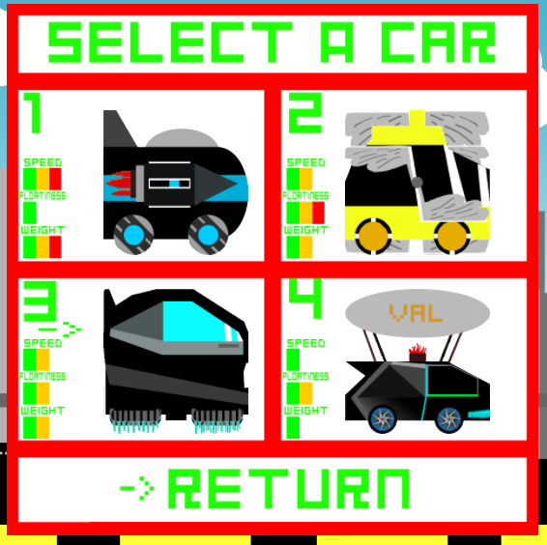
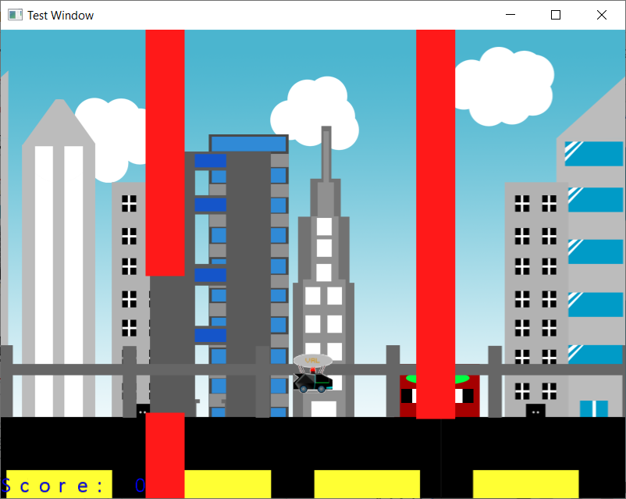
Flappy Car
Camera: 2D (Front view)
Players have to pass through the holes in the wall
100 points for every wall they manage to bypass
End Condition: If the player hit the wall
Collectable Power-Ups
Slow-Down Speed
Score Boost
Destruction of Wall
Random (from above)
All time 5 highest score stored
4 Different Cars with different stats
Weight
Floatiness
Speed

Slide 12
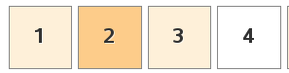

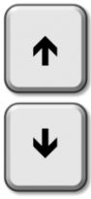
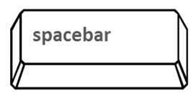
Controls
Select Car (Selection Menu)
Control Cursor
Select Cursor
Spacebar -> Jump

Slide 13
Car Surfers
Camera: 3rd Person
Players have to avoid getting hit by the rocks
End Condition: getting hit by the rocks
Power-Ups
Nitro Boost (which will be accumulated over time)
Usable when Nitro Bar is full
Car moves faster (score increase at a higher rate
Car is able to knock down rocks
Score
Score will increase and the track will move faster overtime
All time high score stored

Slide 14


Controls
A -> Move Left
D -> Move Right
Spacebar -> Activate Nitro Boost

Slide 15
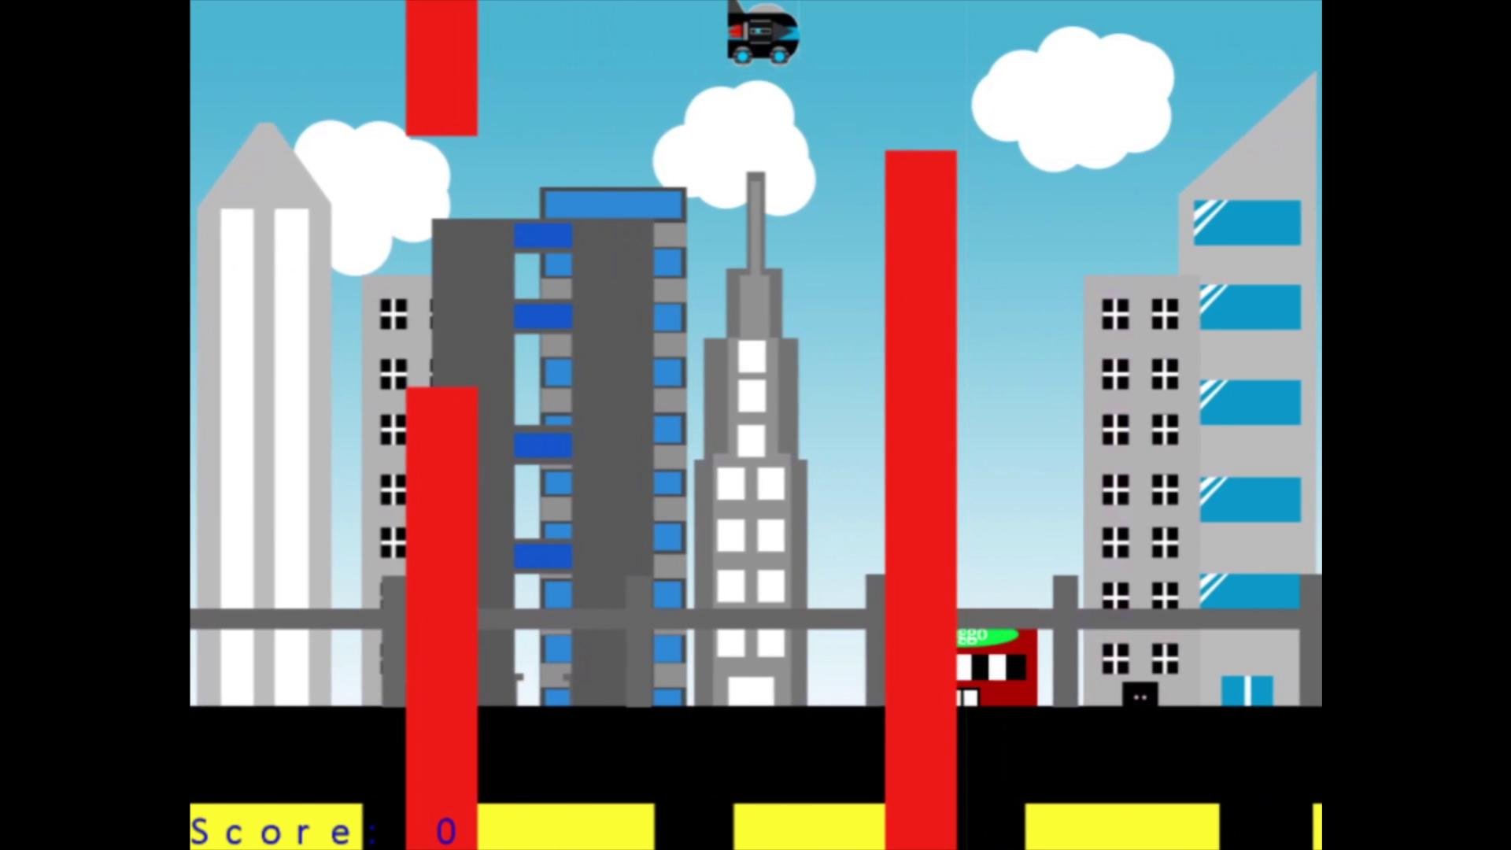
Video

Slide 16
Task Allocation

Slide 17
Jeri
Diegetic Stat Interface
Player Movement
Hardware Abstraction
Singleton Data
Test Driving :
Third Person Camera
Car Class - Implementation
Car Movement
Selection Screen :
First Person Camera
Player Class
Shader

Slide 18
Glenda
Car Surfers (Mini Game 2) :
Car Surfers (Mini Game 2) - Models
Car Surfers (Mini Game 2) - Logics
Car Surfers (Mini Game 2) - Interaction with the main scene (rendering to different state)
Sounds
Shaders

Slide 19
Clement
Flappy Car (Minigame 1) :
Flappy Car (Minigame 1) - Textures
Flappy Car (Minigame 1) - Logics
Drive Testing Collision
Sounds
Shaders

Slide 20
Wai Men
Rendering for Selection Screen :
Selection of Cars for Test drive
Car Class - Base Code
Test driving :
Rendering state
Scene Transitions - implementation
lighting
skybox
Sound
Shader

Slide 21
Val
Model :
Test Drive - Model
Mini Game Booths - Model
Space Shuttle - Model
UI :
UI for Test Drive - Model n Code
UI for start menu - Model n Code
UI for pause menu - Model n Code
UI for Selection Screen - Texture n Code

Slide 22
QnA Time !

Slide 23
THANK YOU

